Slide 1


MACHINE LEARNING / DATA VISUALIZATION – VIKINGS (EXCEL AND JMP)
Jeremy Olson

Slide 2

AGENDA
Introduction
Statistical Findings
Excel Dashboard
Summary
Sample Presentation (Additional File)

Slide 3

INTRODUCTION
Audio Narrated Slides (In video file)
Tools used for statistical analysis
Statistical findings do not mean much if data analysts can not communicate them

Slide 4
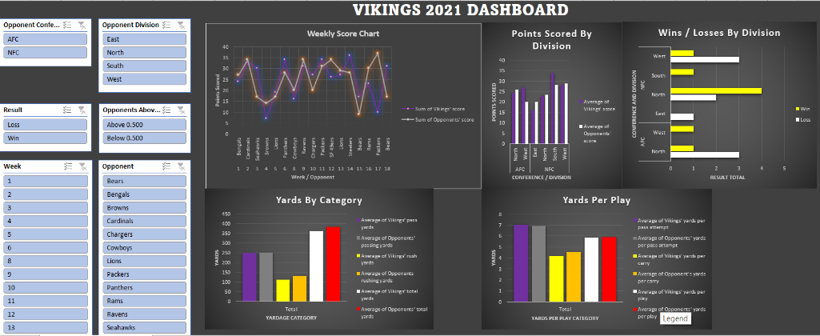
Excel Dashboard

Slide 5
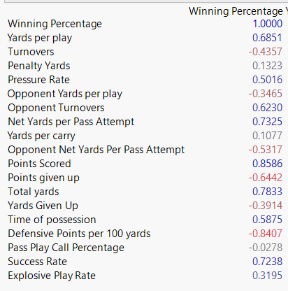
Correlation Analysis
Multicollinearity and normal distribution of our variables were also evaluated

Slide 6
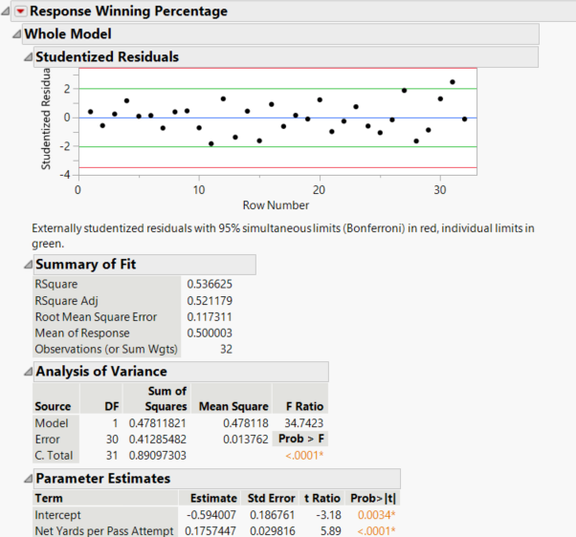
Linear Regression Model – NY/A

Slide 7
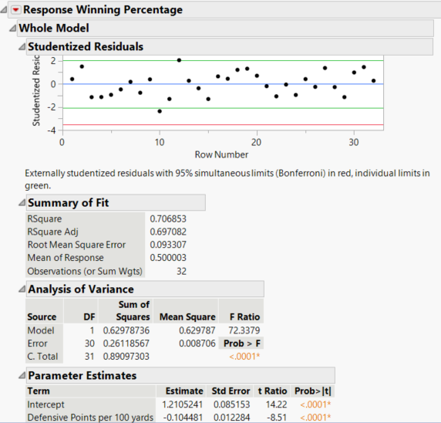
Linear Regression – Defensive Points Allowed Per 100 Yards

Slide 8
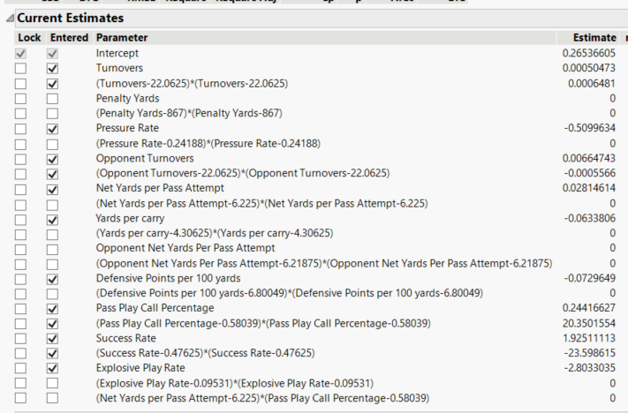
Stepwise Regression

Slide 9
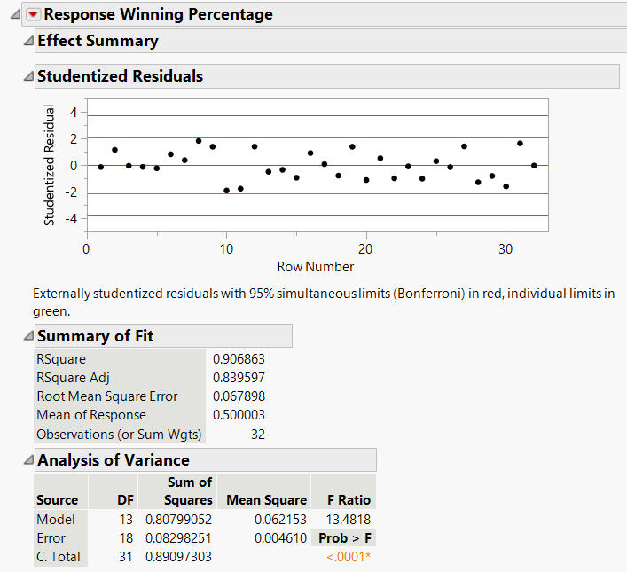
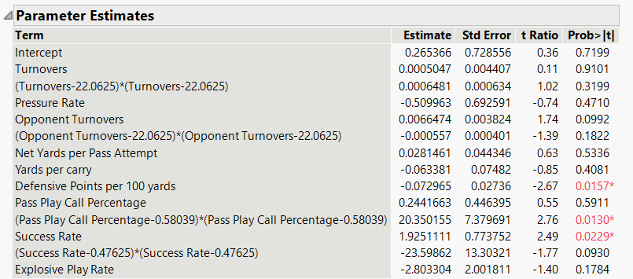
Stepwise Regression – Model Analysis

Slide 10


SUMMARY
Statistical analysis:
1. Scatterplot Trends
Multivariate correlation
Linear Regression and Stepwise Regression
Data Visualization:
Various line charts, bar charts and scatterplots
Used this information to inform a data informed decision
Examined dashboard of the Vikings 2021 season

Slide 11

THANK YOU
Jeremy Olson
olsonjeremy33@gmail.com

